Slide 1
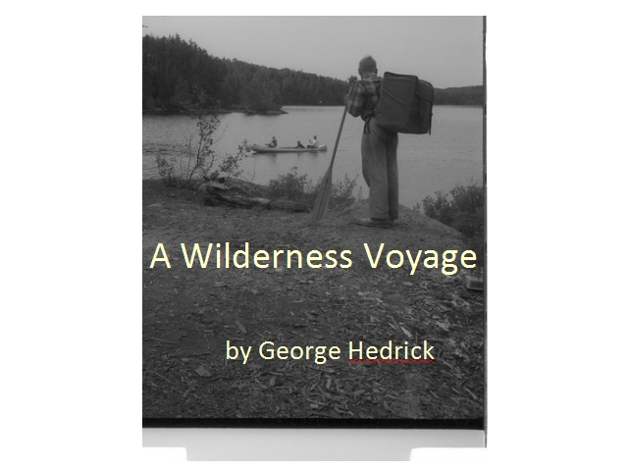

Slide 2
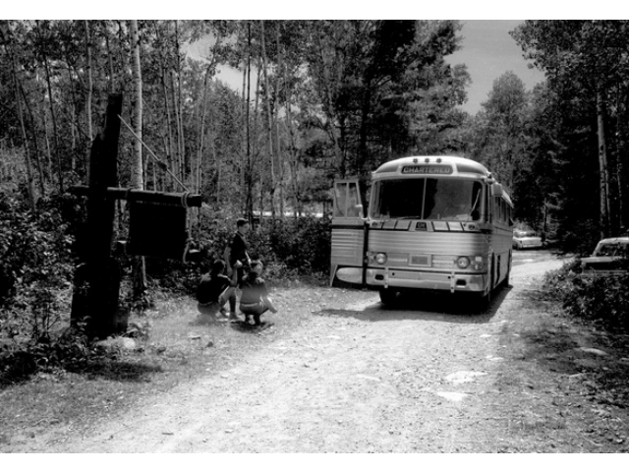
Notes:
After a long hard drive we finally arrive in Ely at the Charles L. Sommers Canoe Base

Slide 3
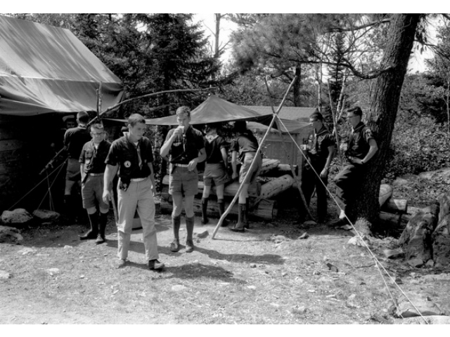
Notes:
Time to jump off the bus for a much needed drink of water. Funny we shall be surrounded by water for the next 10 days.

Slide 4
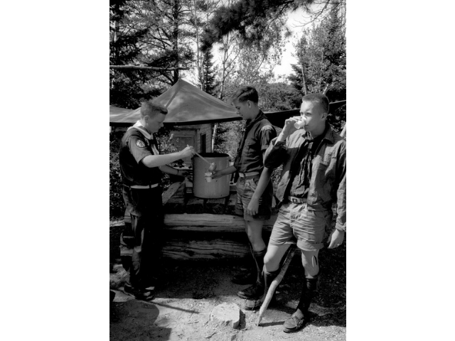

Slide 5
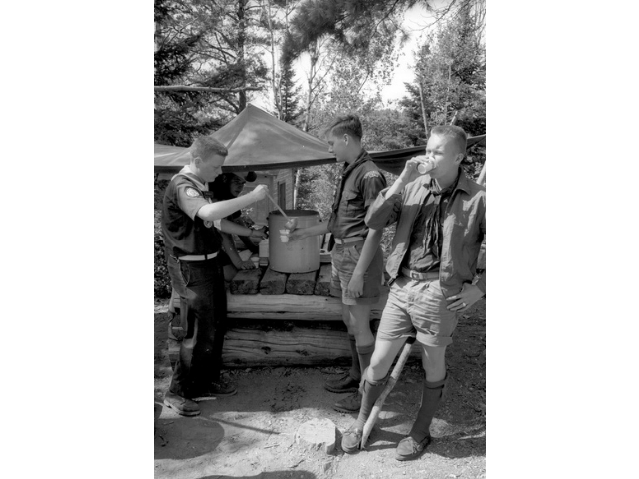

Slide 6
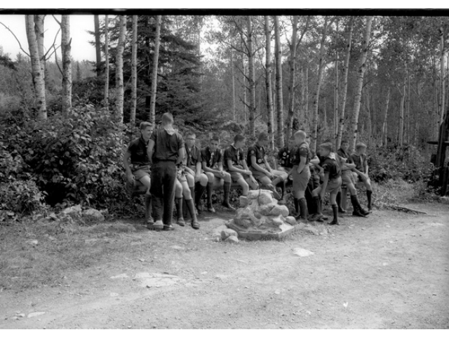
Notes:
Time to meet our guide. Oh here he comes now.

Slide 7
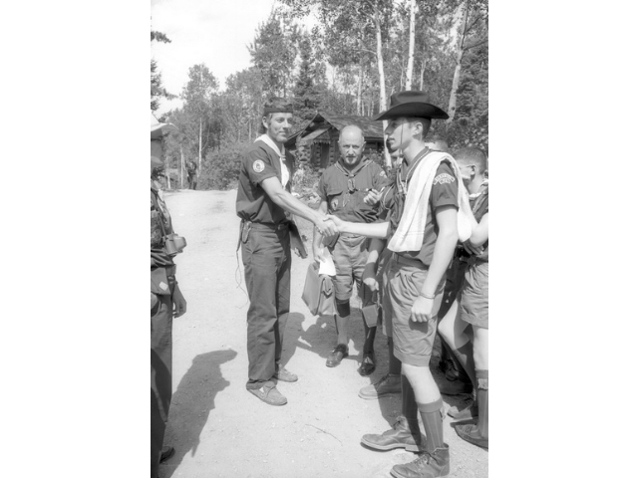

Slide 8
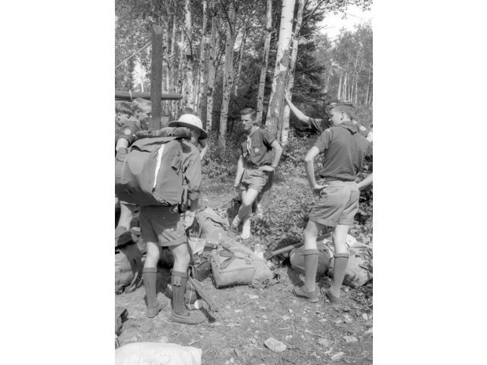
Notes:
Time to take our gear to tent city and change into our swim gear for our swim test and canoe swamp.

Slide 9
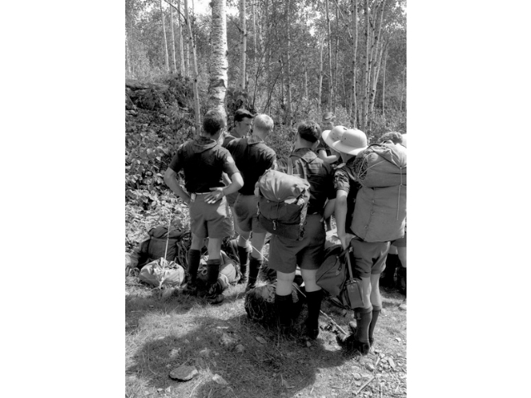

Slide 10
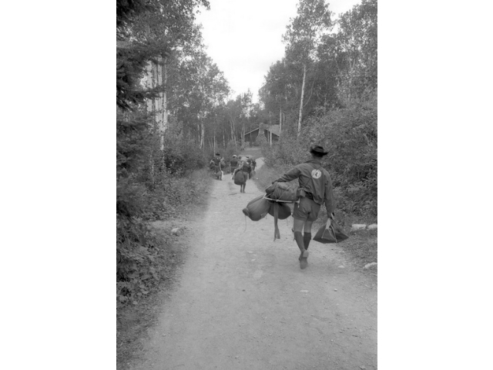

Slide 11
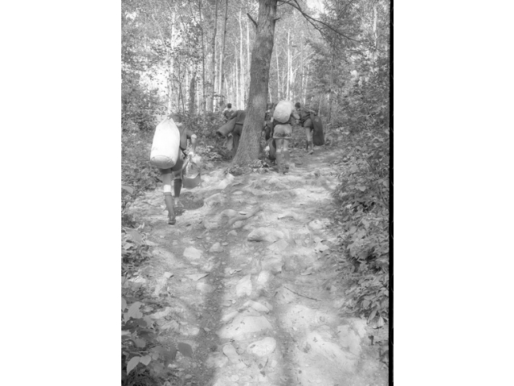

Slide 12
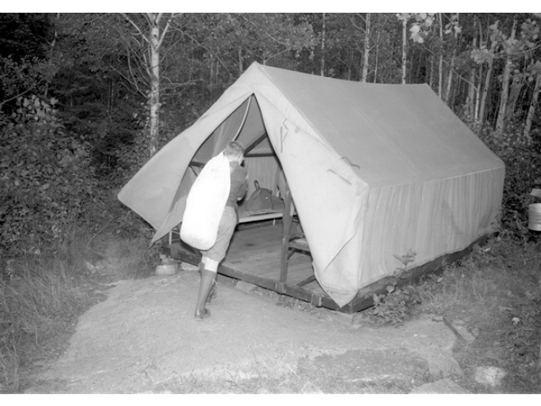
Notes:
This is where we spend our first night before we go out on the water.

Slide 13
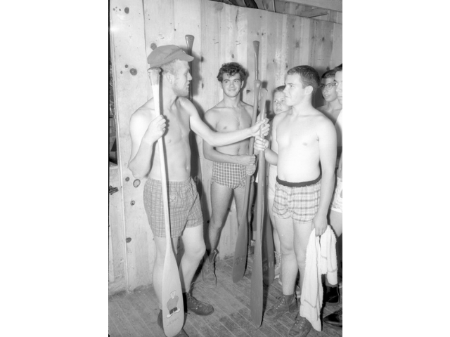
Notes:
In the bottom of the Bay Post is the equipment and paddle lockers. Here we are instructed in proper paddle selection.

Slide 14
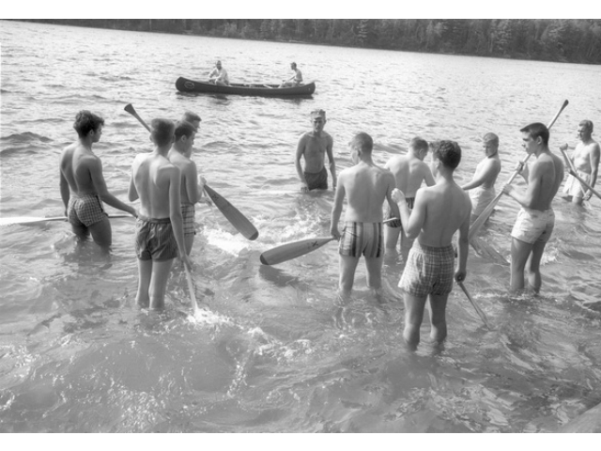
Notes:
Down at the water front our guide gives us some pointers on the how toos of paddling. We will be using the Draw, Sweep, Pry, Backstroke and J.

Slide 15
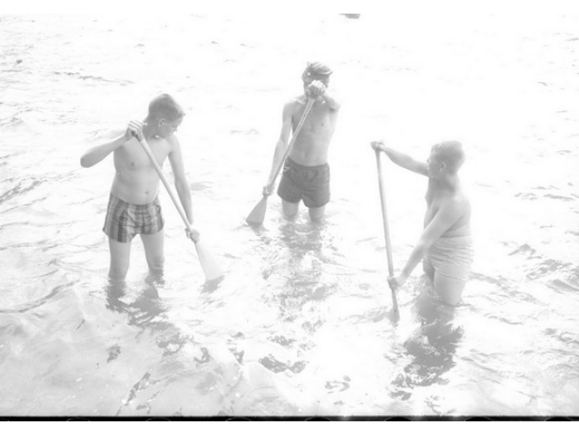

Slide 16
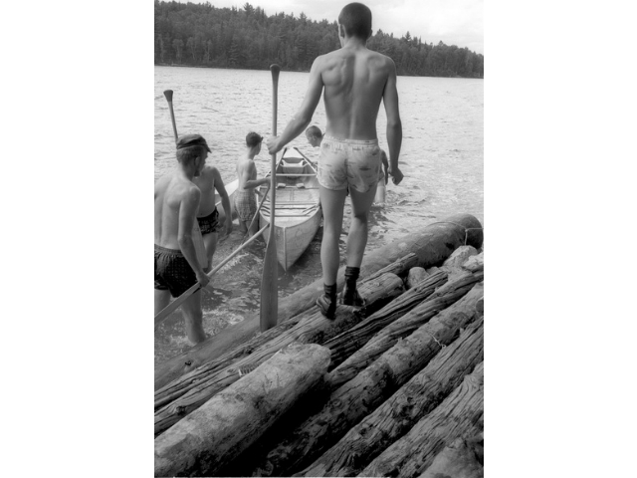
Notes:
After a little bit of instruction we are going to try our hand at swamping and then paddling back to shore with a canoe full of water.

Slide 17
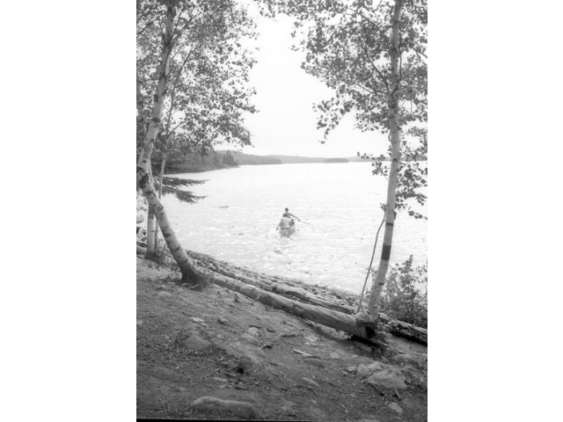

Slide 18
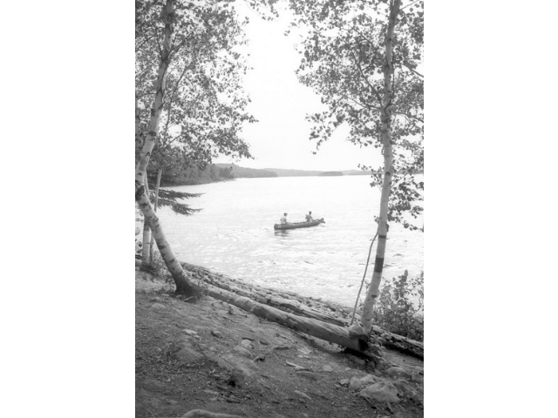

Slide 19
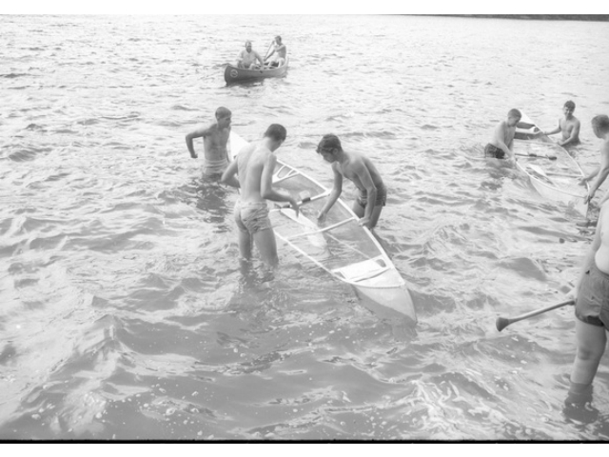

Slide 20
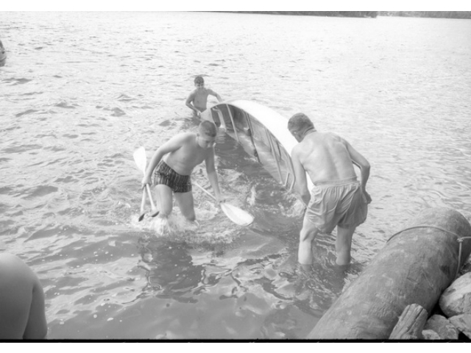
Notes:
Get me a town that is cold water.

Slide 21
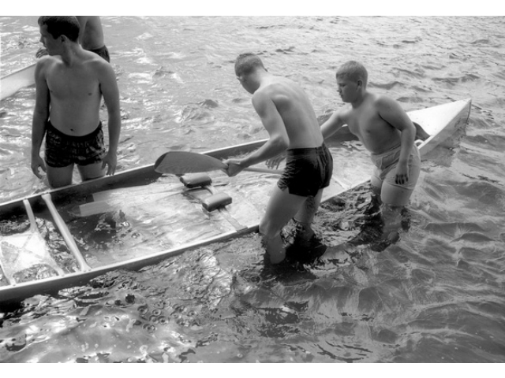

Slide 22
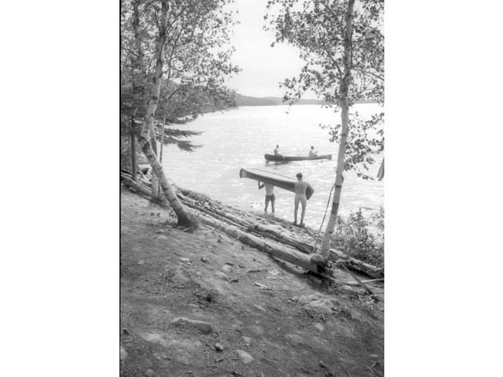

Slide 23
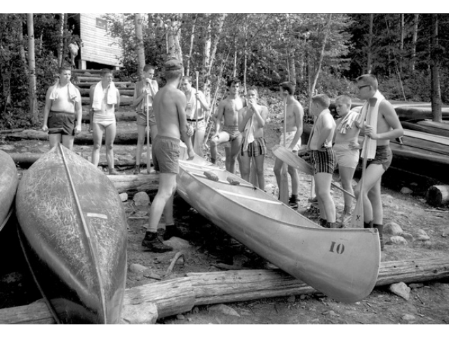
Notes:
Once we learned the fine art of swamping now we learn how to flip a canoe up by ourselves. Out here everything is a single man carry.

Slide 24
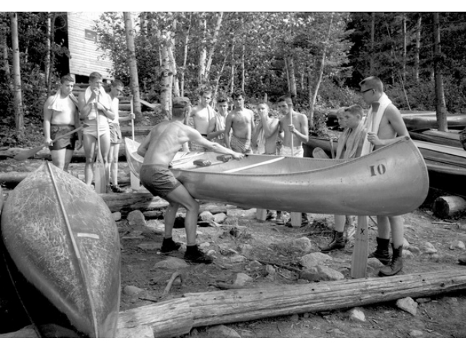

Slide 25
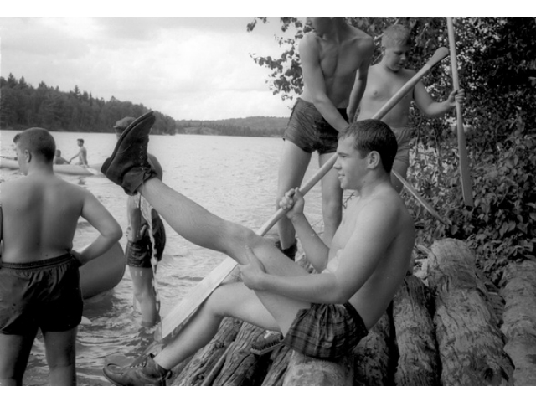
Notes:
Now to get these wet cold boots off and dry out before we pack our food.

Slide 26
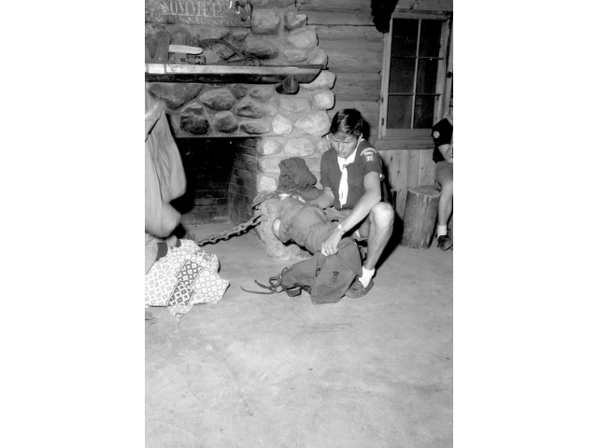
Notes:
Our guide give us some pointers on how to pack and what to take and leave behind.

Slide 27
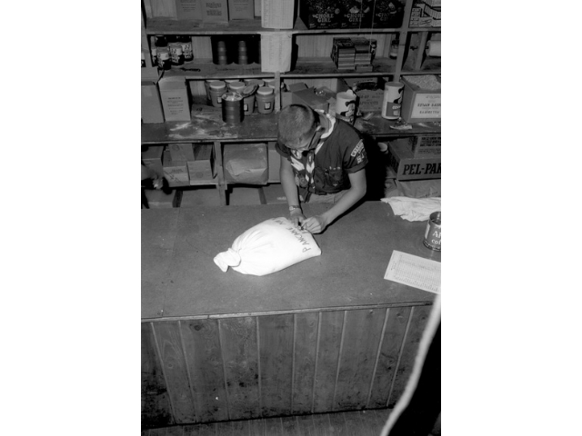
Notes:
Well here we are at the Bay Commissary. This is where we get our food for the trip.

Slide 28
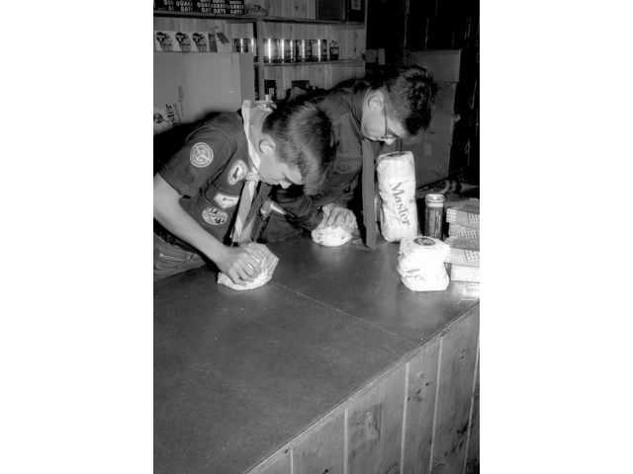
Notes:
Everything gets squished to fit into the pack. Even these loafs of bread.

Slide 29
Notes:
Now it is time to squeeze our food into these Duluth packs. The cardboard box gives the pack support and helps keep the food in some type of order.

Slide 30
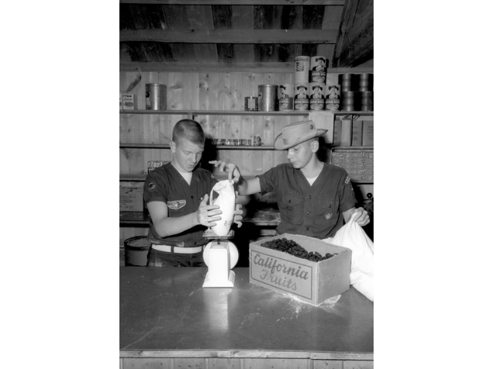
Notes:
We must measure everything out to make sure that there will be enough food to last the trip.

Slide 31
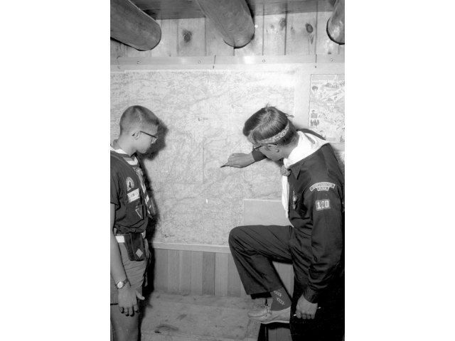
Notes:
Once we are dried off then our crew chief meets with the guide to help select our route for the trip

Slide 32
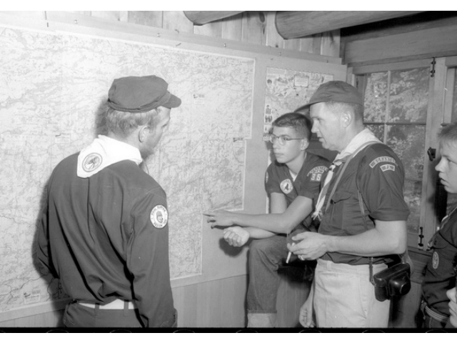
Notes:
Our scoutmaster weighs in on where he would like to go.

Slide 33
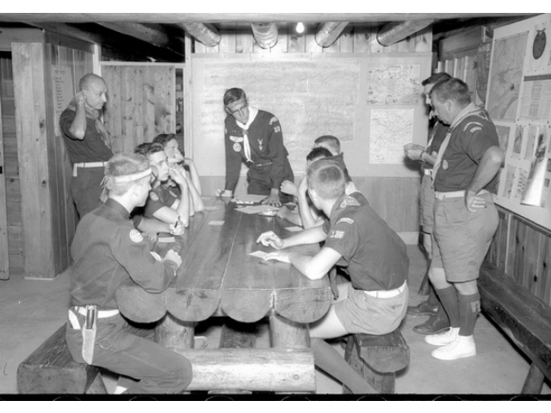
Notes:
After our guide has sized up our abilities and careful consideration by our crew we have settled on our trip rout.

Slide 34
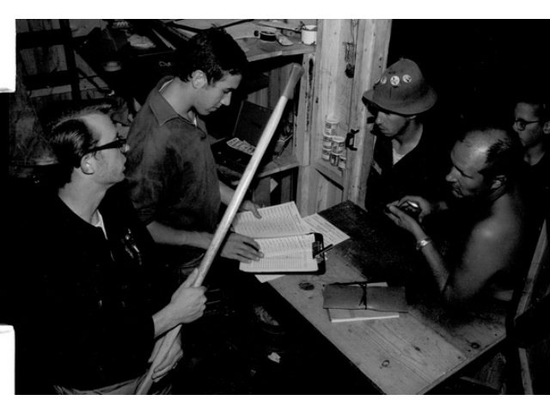
Notes:
Time to start checking out our trip equipment. We need a complete kettle back, personal packs, paddles, life jackets.

Slide 35
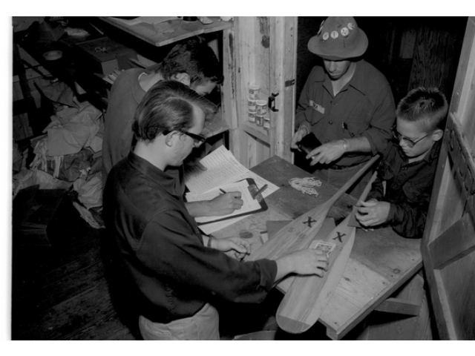

Slide 36
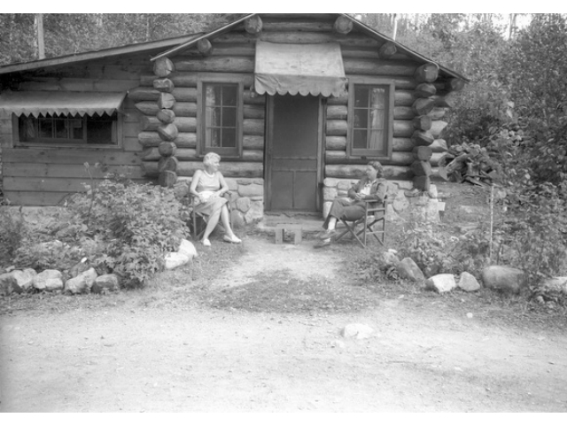
Notes:
Relaxing outside of the directors cabin.

Slide 37
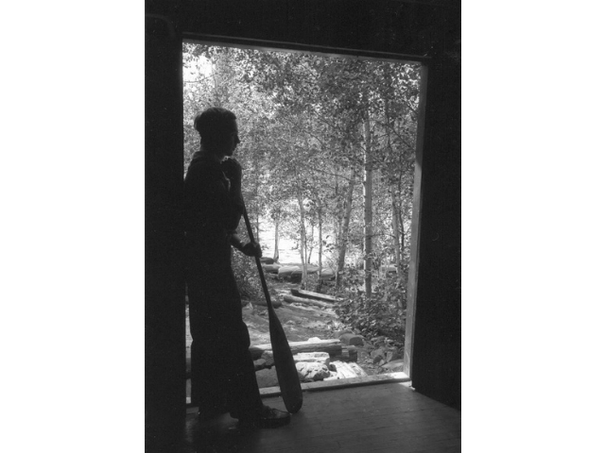

Slide 38
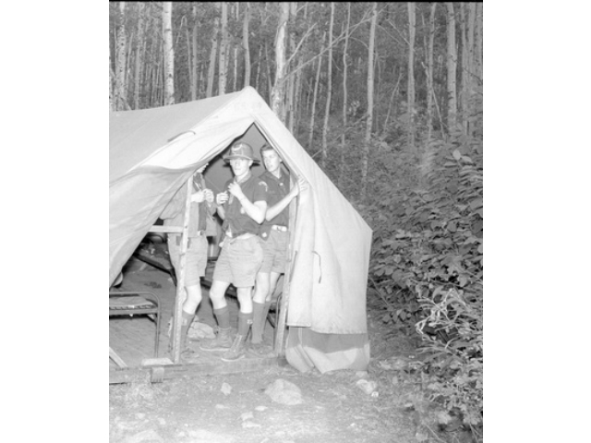
Notes:
Time to get cleaned up for dinner

Slide 39
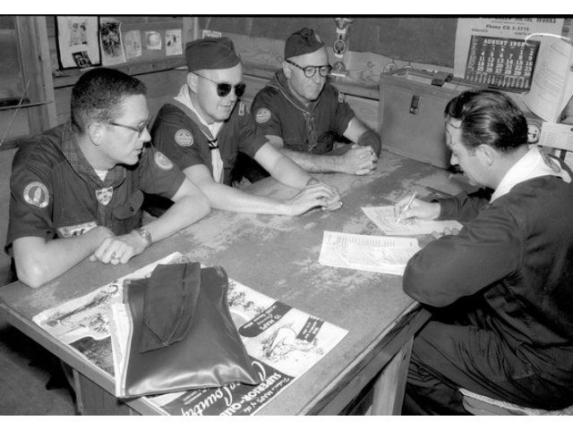
Notes:
Upon check in our scoutmaster meets with the Base director Cliff Hanson. He goes over our records and health forms.

Slide 40
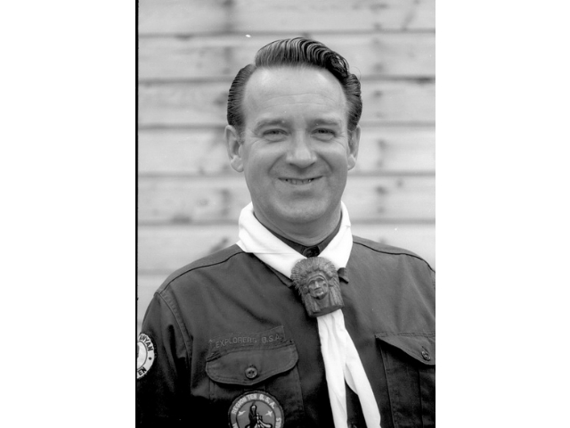
Notes:
Cliff Hanson

Slide 41
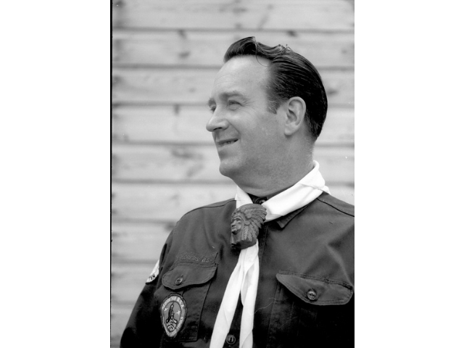

Slide 42
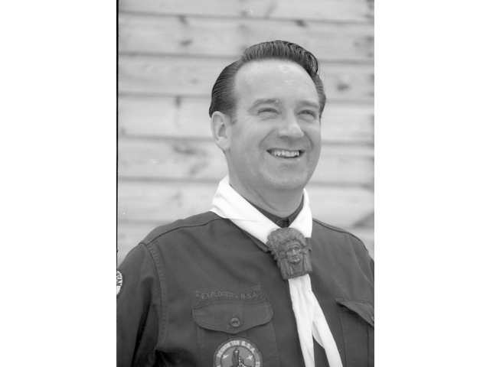

Slide 43
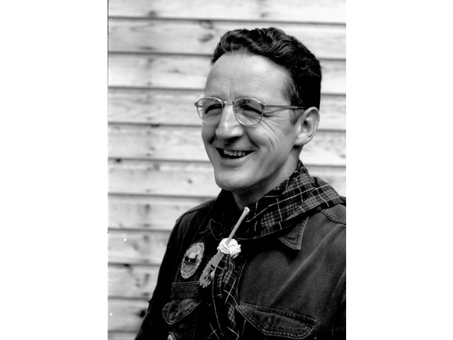
Notes:
Henry Bradlich. One of the earliest staff members of the Canoe base. He started out canoeing here in the early 1920‚Äô2

Slide 44
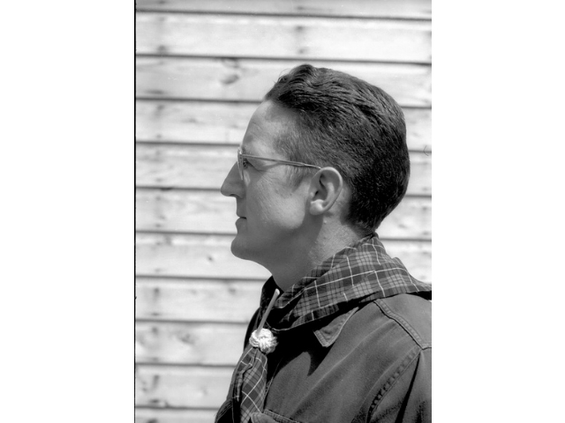

Slide 45
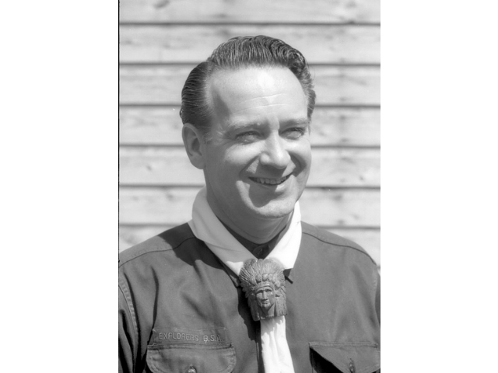

Slide 46
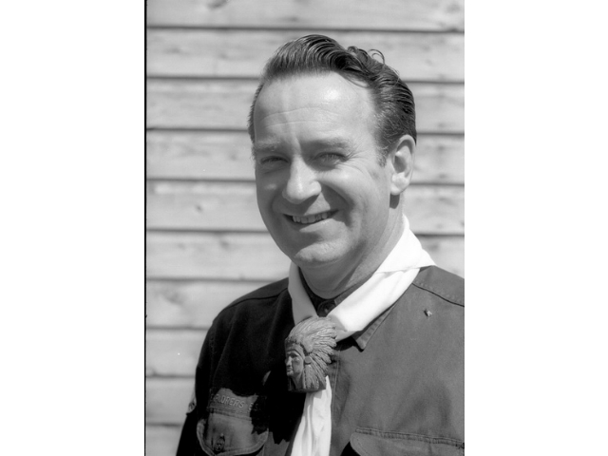

Slide 47
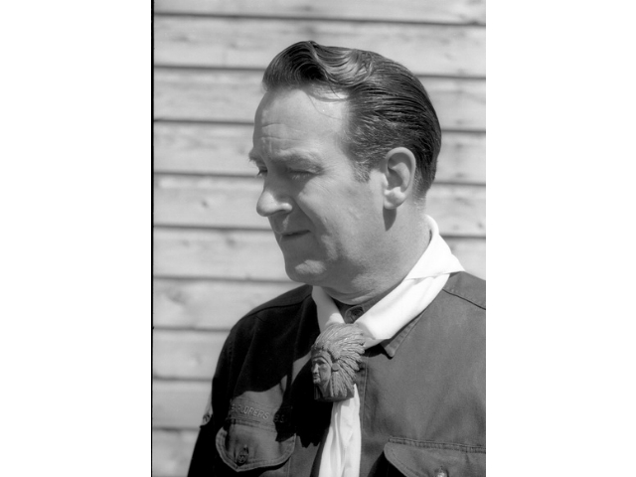

Slide 48
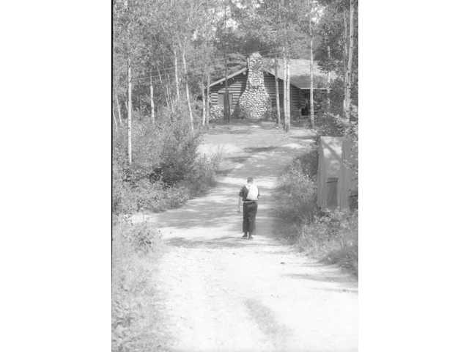

Slide 49
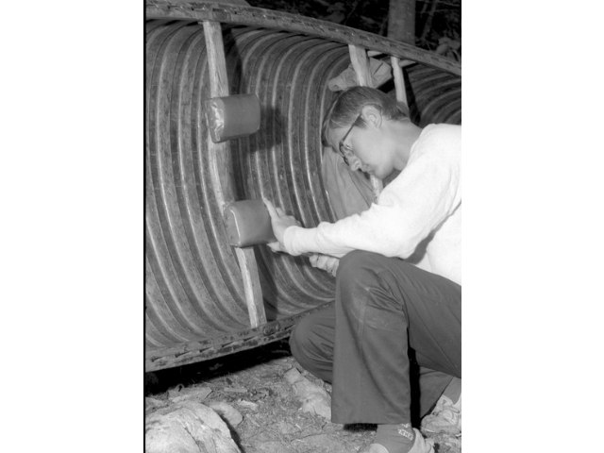
Notes:
Our guide is making some last minute repairs to his Sleiga canoe. It was made by a resident of Ely Joe Seliga. They are wood canvas and handmade in his garage.

Slide 50
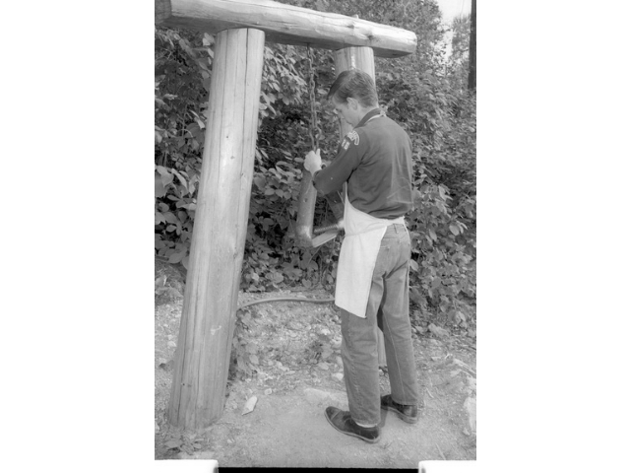
Notes:
Dinner Time.

Slide 51
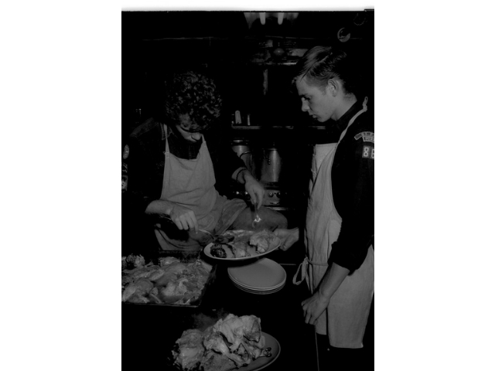
Notes:
Chow time. Our last home cooked meal before heading out into the woods.

Slide 57
Notes:
This is the base post office. I am hoping to get mail from home when I get back.

Slide 60
Notes:
This is the lodge. It was built in the winter of 1941.

Slide 61
Notes:
After every trip the canoes get a thorough scrubbing.

Slide 67
Notes:
One more thing to do is get our trip picture taken. Each crew get a souvenir photo

Slide 69
Notes:
We the time has come. We are about to get out on our way.

Slide 70
Notes:
First day out. We are heading North up the Moose Lake chain for the Canadian border.

Slide 73
Notes:
Here it is Canada. First we must cross our first portage and check in with the Canadian Customs officer and Park Ranger.

Slide 79
Notes:
After our paperwork has been approved we are free to enter Canada for out wilderness voyage.

Slide 83
Notes:
Mom would never believe this. I am using my paddle to stir our drink mix in the water bucket.

Slide 84
Notes:
Peanut butter and jelly on 1/8 inch thick break. It is almost thinner than a sheet of paper. We had to peel each slice out of the loaf.

Slide 92
Notes:
Oops my cup got away from me.

Slide 93
Notes:
Time to walk up stream.

Slide 95
Notes:
This is not how we were taught to put a canoe in the water. But those rocks are slick.

Slide 97
Notes:
Time to bed down for the night.

Slide 102
Notes:
At last no more waking up stream.

Slide 109
Notes:
Now it is time to portage once more.

Slide 112
Notes:
This is a US and Canadian border marker.

Slide 113
Notes:
Time to set sail.

Slide 114
Notes:
Now this is the life. I hope the winds holds up for a while.

Slide 121
Notes:
Fish would be good for dinner.

Slide 122
Notes:
After a long day of paddling it is time to cook dinner and bake a cake.

Slide 130
Notes:
Sunday rolls around and we take time for a chapel service.

Slide 143
Notes:
Morning comes early and we need a good fire to cook French toast. Here we go again. Peel the bread off.

Slide 144
Notes:
A Canadian Jay flew in for a quick snack.

Slide 149
Notes:
Now that‚Äôs what I‚Äôm talking about. Fish for breakfast.

Slide 153
Notes:
A little cleanliness even out in the wilderness.

Slide 158
Notes:
Helping hands made this portage a little easier

Slide 160
Notes:
Cleaning out our mess gear before packing it away

Slide 169
Notes:
More fish. We all got to take turns filleting the fish. Today it is walleye.

Slide 174
Notes:
Pies for desert made in our reflector oven.

Slide 182
Notes:
A little chipmunk coming in for a raid.

Slide 190
Notes:
Rolling out pie crust on the seliga.

Slide 195
Notes:
Taking it all in. At first the trip was more than I thought I could bear. But now, I can‚Äôt see of doing anything more fun.

Slide 207
Notes:
That‚Äôs right you can drink right out of the lake.

Slide 219
Notes:
Beaver Lodge

Slide 220
Notes:
Where there is a beaver lodge there is a dam to cross over.

Slide 235
Notes:
A walleye committing suicide by jumping in our canoe.

Slide 240
Notes:
Mom out here I will eat just about anything.

Slide 257
Notes:
Beaver hard at work.

Slide 259
Notes:
With work done in camp there is free time to fish.

Slide 271
Notes:
Homeward bound. It is back to Prairie Portage. This time we do not need to see any Canadian officials. It will be the US Customs officer in Ely.

Slide 284
Notes:
At first it was all I could do to carry one. But now look at me. Packing is style.

Slide 289
Notes:
Our last night out and we are all amazed at how fast this trip went.

Slide 292
Notes:
Time to sing some camp songs. We are all dreaming of our supper at the base tomorrow night.

Slide 294
Notes:
Just a couple more portages and we will be back to the base.

Slide 300
Notes:
This is the proper way to put on a Duluth pack.

Slide 305
Notes:
Try a seliga on for size.

Slide 321
Notes:
Our last day and everything must be clean before we get back to base.

Slide 325
Notes:
Well we made it. Time to hit the Sauna, get the mail, and a big cup of coffee. Most of all dry clothes and shoes.

Slide 327
Notes:
I can‚Äôt believe it . No more squished bread. Real home cooked food. Milk, Chicken, Mashed potatoes, gravy, peas, corn. And did I say NO SQUISHED BREAD.

Slide 328
Notes:
Cliff Hanson and family.

Slide 329
Notes:
Time for our last campfire in the lodge. Songs and skits by everyone.

